Slide 1


Employee Data Analysis using Excel
STUDENT NAME: B.LALITHA
REGISTER NUMBER: 122202376
DEPARTMENT: B.COM CS
COLLEGE NAME:
GURU SHREE SHANTHI VIJAY JAIN COLLEGE FOR WOMEN

Slide 2


EMPLOYEE PERFORMANCE ANALYSIS
EXCEL

Slide 3


1 Problem Statement Project Overview
End Users
2
Our Solution and
Proposition
Dataset Description Modelling Approach
Results and Discussion
7 Conc lus ion
3
s
8

Slide 4

Employee performance is defined as how well a person executes their job duties and responsibilities. The companies assess their employees performance on an annual or quarterly basis to define certain areas.
The Dataset overview of an employee, contains the information about employees in a company.

Slide 5

The project involves analyzing employee data using Excel which helps in gaining the knowledge regarding organizational data, performance statistical analysis by creating visualizations to understand the employee per f ormance s.

Slide 6


The end users in employee performance analysis include:
Human Resource management professionals.
Data Analysts.
Team Leaders.

Slide 7





”Filtering- purpose to fill the missing values.
”Conditional formaŁting- blank values.
•Using- Pivot table and chart.

Slide 8


Employee data set- Kaggle There are 26 features The important ten features are,
der
› mployee
eratings

Slide 9


* Performance Level— These include the categories such as Levels in very high, high, medium, low, etc...

Slide 10

The modelling in this employee performance analysis project includes the following:
*Data collection
*Data cleaning “Results
*Pivot table
*Chart

Slide 11
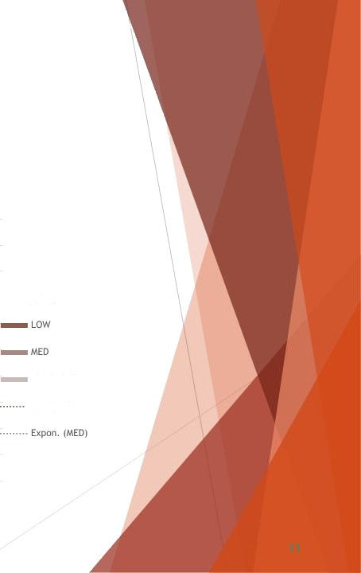
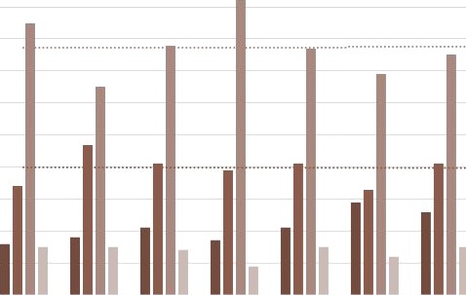
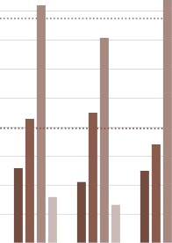
RESULTS
Employee Performance Analysis
i0O
90
BO
70
HIGH
60
50
é0
VERY HIGH
30
Linear (LOW)
20
10
0
BPC
CCOR
EW
tJEL
PL
PTZ
SVG
TNS
WBL

Slide 12
The conclusion is the employee data analysis reveals the key insights in workforce performance and areas needed for improvement. The effective data analysis provides a foundation for the improvised planning and operational developments, which leads to a motivated and productive workforce environment.

